Slide 1

What is occupational justice?

Slide 2

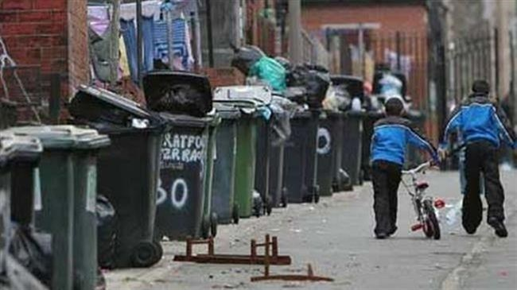
Doing
Being
Becoming
Core principle: participation in occupations affects our health, wellbeing, identity and development
“Restrictions on opportunities for participation in meaningful occupations or the imposition of occupations that are detrimental or not meaningful can be harmful, and are therefore unjust” (Stadnky et al. 2010. As cited in Durocher, 2017, p.8)

Slide 3
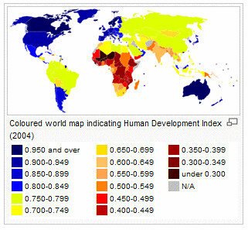
Human Rights Perspective
The enjoyment of the highest attainable standard of health is a fundamental right of every human being
Equal distribution of resources
The provision of healthy occupational and environmental conditions (World Health Organisation 2008, 2015)

Slide 4
Occupational Justice – a definition
Individuals should have the right to exercise their capabilities to participate in occupations to develop and sustain their identity, health, well-being and quality of life (Stadnyk et al., 2010)
Do individuals in your setting have the right to exercise their capabilities?
  Rules
  Regulations
  Waiting lists
  public vs private healthcare
  Custom and practice
  Power imbalance

Slide 5
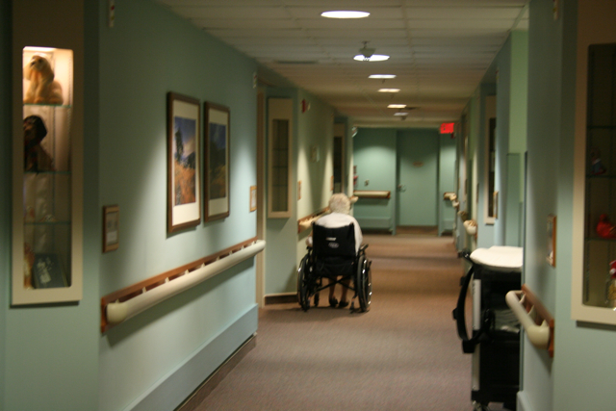
Occupational deprivation
Preclusion from participation in meaningful, health-promoting or necessary occupations because of forces beyond one’s control (Whiteford, 2000)

Slide 6
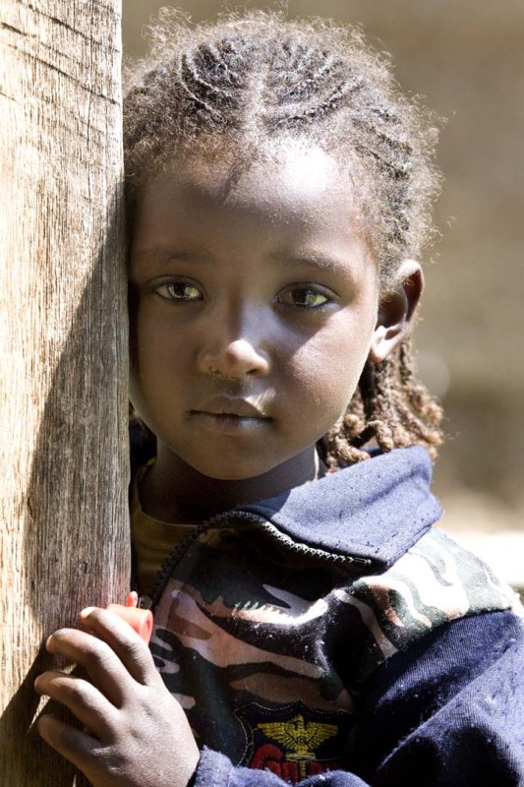
Occupational apartheid
Denial of permission to participate in meaningful occupations based on personal characteristics (Kronenberg and Pollard, 2005)

Slide 7
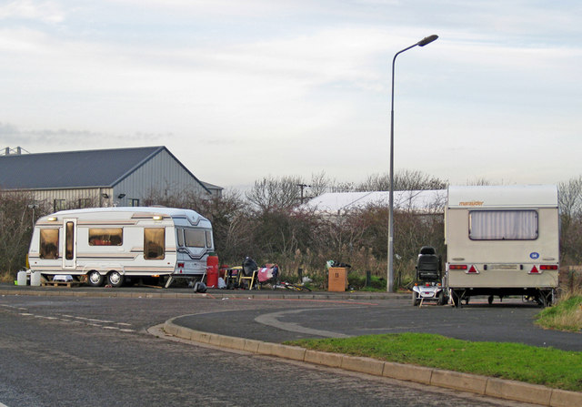
Occupational marginalisation
Denial or lack of opportunity for participation in occupation based on invisible societal norms or expectations (Stadnyk et al., 2010)

Slide 8
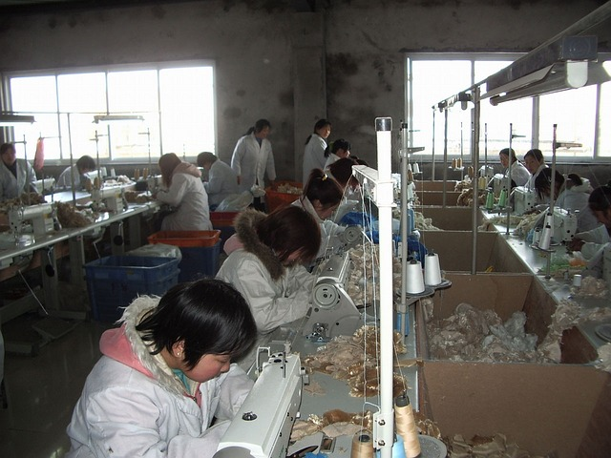

Occupational imbalance
Individual level: harm related to participation in one occupation at the expense of another
Societal level: inequitable distribution of opportunities for participation in meaningful, beneficial or valued occupations (Stadnyk et al., 2010)

Slide 9
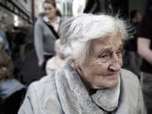
Occupational alienation
Imposition of participation in occupations that are not meaningful (Stadnyk et al., 2010)

Slide 10
Examples of occupational injustice
……..when a difference between public and private patients mean that one person receives their wheelchair sooner than another = occupational deprivation
……..when funding cuts reduce activities in a residential setting = occupational imbalance/deprivation
……..when a child from the Travelling community is assumed not to want to do their Leaving Certificate = occupational marginalisation
……..when person living in a mental health hostel is not allowed to cook or have a room to themselves = occupational deprivation/marginalisation

Slide 11
Examples of occupational justice-focused OT
……..when an OT advocates for a client to be able to do activities independently
……..when an OT attends meetings where funding decisions are being made to call for fairness
……..when an OT consults with clients as to what activities would be meaningful to them before devising an activity programme in a setting
……..when an OT watches out for unconscious bias in the workplace towards people on the basis of gender, ethnicity, diagnosis or other factors

Slide 12
References
Durocher, E. Occupational Justice – A fine balance for occupational therapists. In Occupational Therapies without Borders: Integrating Justice with Practice (2nd Ed) D. Sakellariou & N. Pollard (Eds.) (2017). Elsevier: London, UK, pp. 8-18
Kronenberg, F., & Pollard, N. (2005). Overcoming occupational apartheid: A preliminary exploration of the occupational nature of occupational therapy. In Kronenberg, F. et al. (Eds.) Occupational Therapy Without Borders: Learning from the Spirit of Survivors. Elsevier Churchill Livingstone: Toronto ON.
Stadnky, R., Townsend, E., & Wilcock, A. (2010). Occupational Justice. In C. Christiansen & E. Townsend (Eds.), Introduction to Occupation: The Art and Science of Living (2nd Ed.) Pearson Education: Upper Saddle River, NJ
Whiteford, G. (2000). Occupational deprivation: Global challenge in the new millennium. British Journal of Occupational Therapy, 63(5), 200-204
World Health Organisation (2008). The Right to Health. https://www.who.int/gender-equity-rights/knowledge/right-to-health-factsheet/en/
World Health Organisation (2015). Human Rights. https://www.who.int/topics/human_rights/en/

